Slide 1
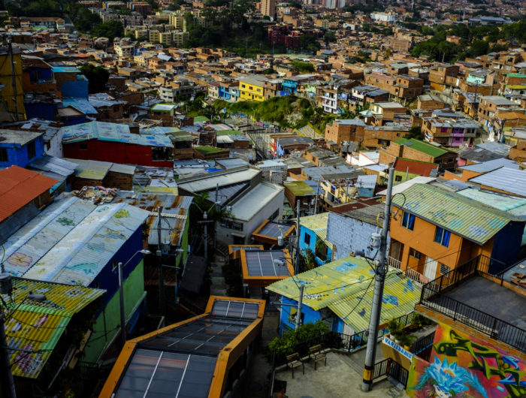
FROM MULTIDIMENSIONAL POVERTY INDEX BY BLOCK TO AVERAGE BY URBAN NEIGHBORHOOD USING FREE DATA FROM FOURSQUARE.
Rodriguez, Joan
A CASE STUDY MEDELLIN, COLOMBIA
January/2021

Slide 2
TABLE OF CONTENTS
1. INTRODUCTION
1.1 PROBLEM
1.2 INTEREST.
2. DATA
2.2 DATA CLEANING
3. METHODOLOGY
3.1 EXPLORATORY ANALYSIS
3.2 PREDICTIVE MODELING
4. RESULTS
4.1 FINAL MAP
5.DISCUSSIONS
6.CONCLUSIONS
7.REFERENCES
1

Slide 3
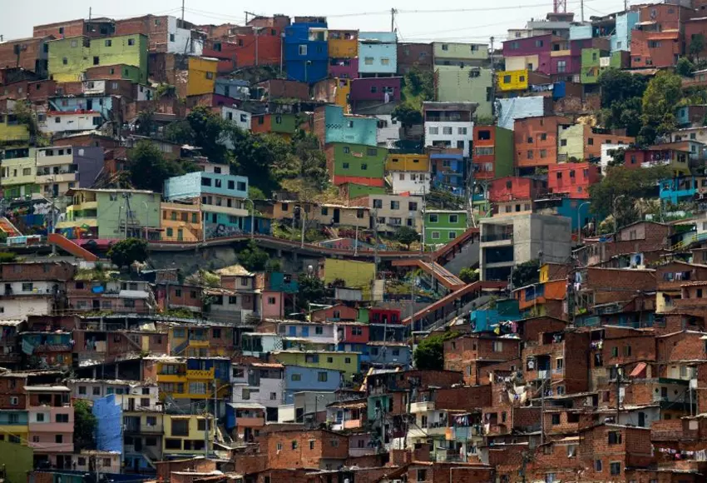
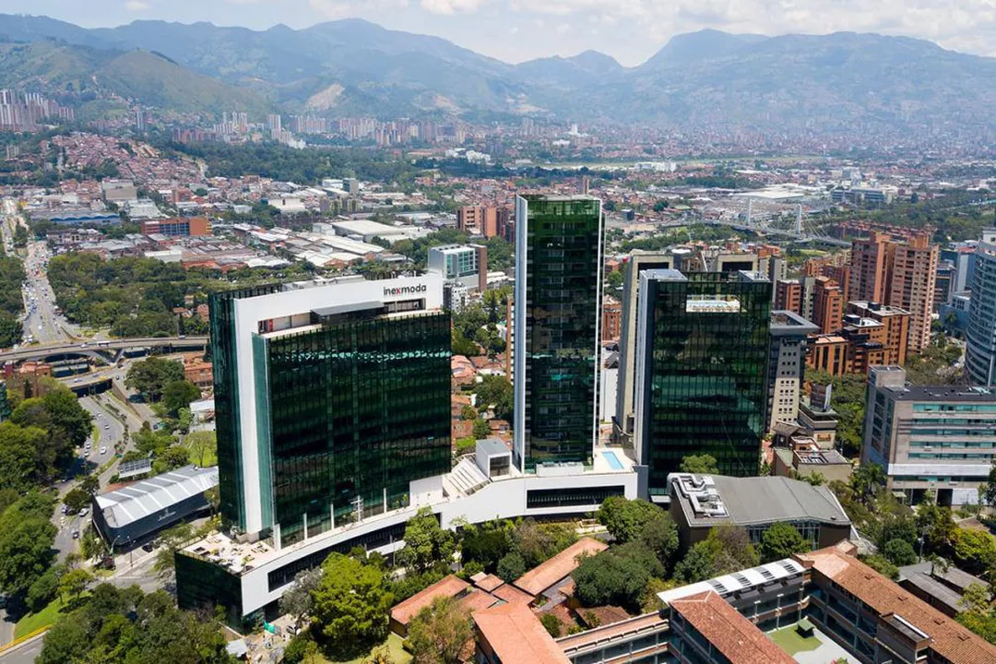

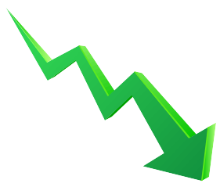
1

Slide 4
1. INTRODUCTION

Slide 5
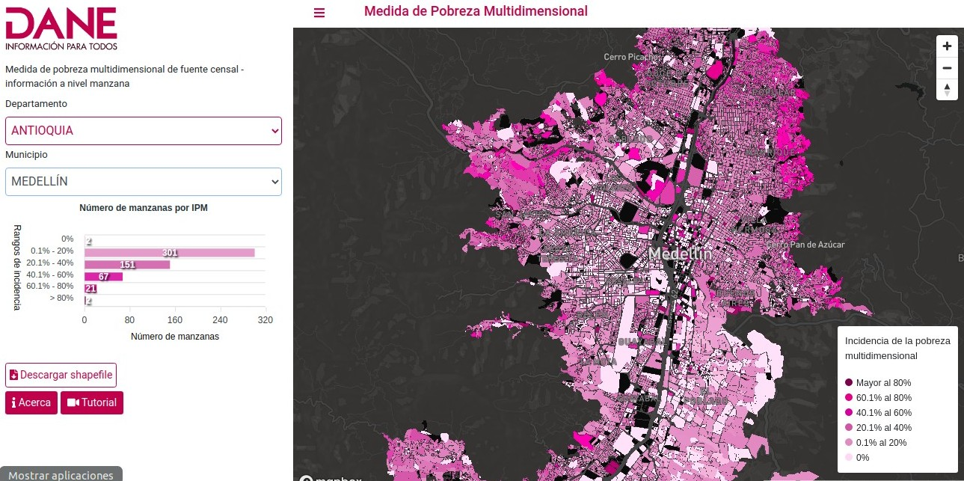
Multidimensional Poverty Index(IPM)
Multidimensional Poverty Index (IPM) looks beyond income to understand how people experience poverty in multiple and simultaneous ways. It identifies how people are being left behind across three key dimensions: health, education and standard of living, comprising 10 indicators. People who experience deprivation in at least one third of these weighted indicators fall into the category of multidimensional poor.
1

Slide 6
1.1 PROBLEM
The Medellin city, uses this index by every block in the urban city, according to the last census data, but it is without information about every neighborhood. In addition, it does not have data about any relationship with principal venues around every neighborhood.
Taking in count the previous information, now the major question is: could the closer venues from each neighborhood has a relationship with poverty and with this data is possible to do prediction like an approximation to Multidimensional Poverty Index?
Using Machine learning and foursquare free data, we will try to resolve this!!!
1

Slide 7
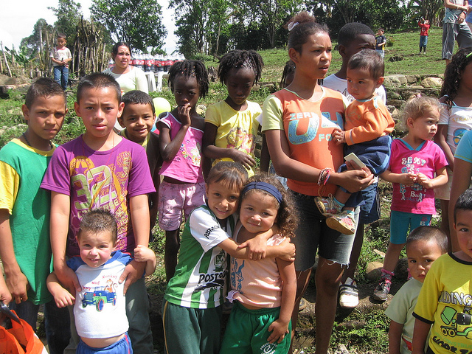
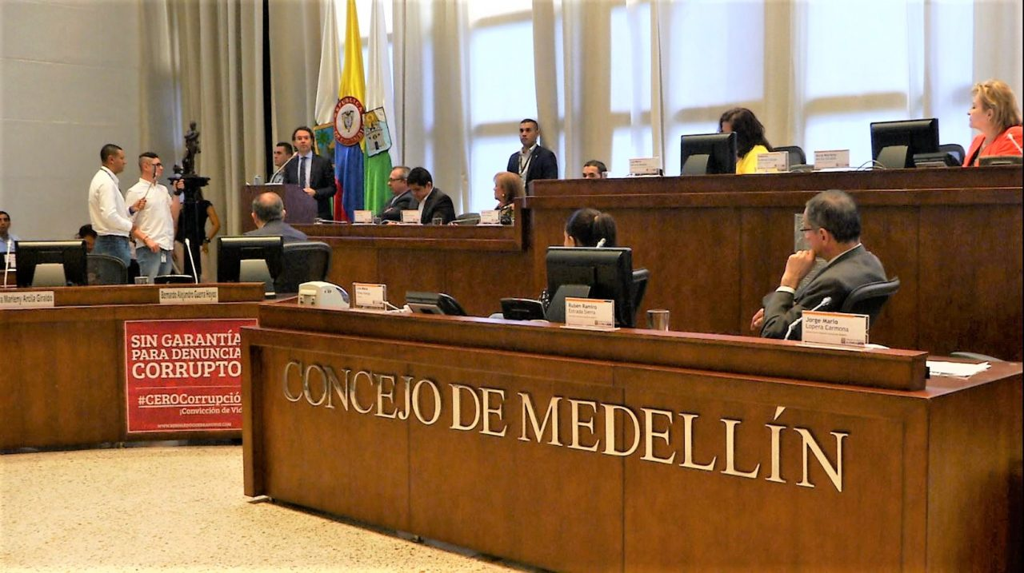
1.2 INTEREST
General population and government are interested in deep knowledge about Multidimensional Poverty Index and how new changes and effort could reduce it. Any new prediction or relationship could be a useful tool in this effort.
1

Slide 8
1. DATA

Slide 9




2.1 DATA SOURCE
Free data from the last census in the year 2018, Multidimensional Poverty Index (MPI) is available at Census DANE MPI like a shape file with it is index for each block in the city.(Figure 1)
Data about every neighborhood is available at Neighborhoods Medellin like a shape file.
With QGIS software (3) we change the data from shapefile to geojson to see neighborhoods and extract excel spreadsheets, to use Multidimensional Poverty Index.
Data about venues is available at foursquare using a free account.
1

Slide 10
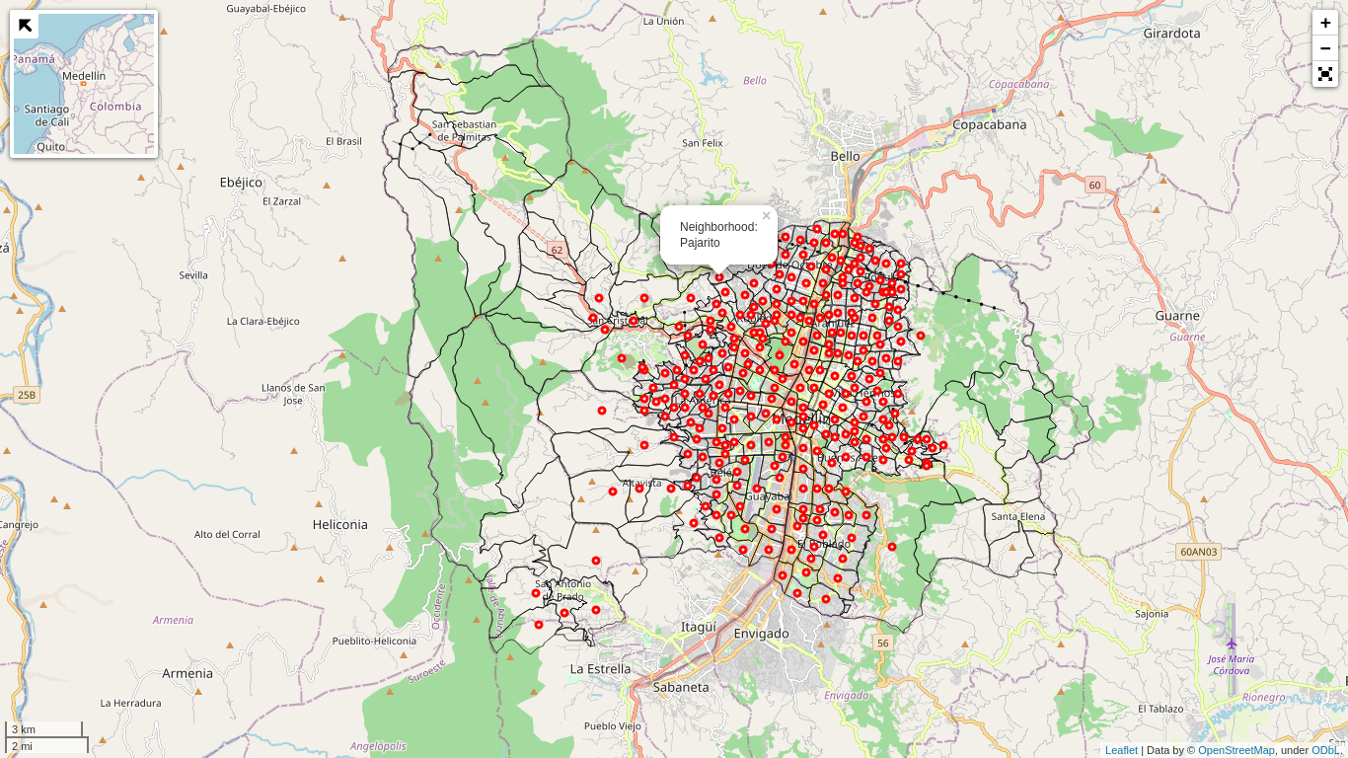
2.1 DATA CLEANING
Data with Neighborhood geometries was downloaded and opened with QGIS software (3) to transform data from shapefile to geojson, additionally extract coordinates inside each 298 urban neighborhood and excel spreadsheet with Multidimensional Poverty Index by block.
Urban Neighborhoods points (Red points) with coordinates in a Folium Map.
1

Slide 11
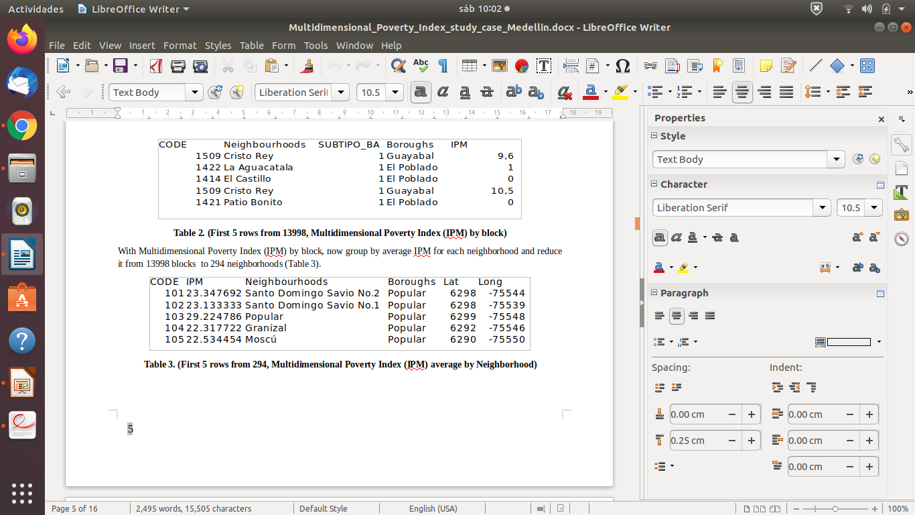
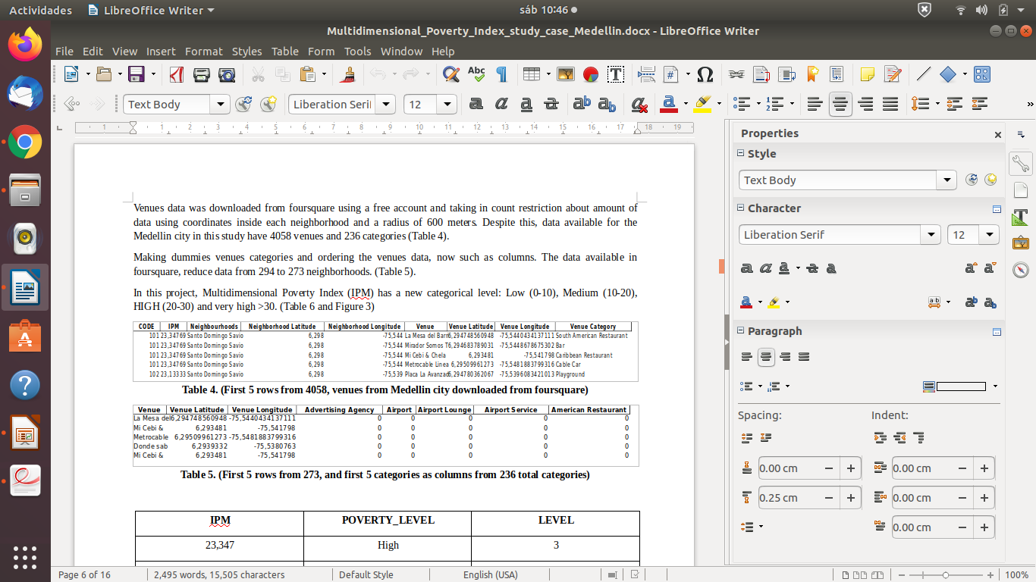
2.1 DATA CLEANING
With Multidimensional Poverty Index (IPM) by block, now group by average IPM for each neighborhood and reduce it from 13998 blocks to 294 neighborhoods.
First 5 rows from 294, Multidimensional Poverty Index (IPM) average by Neighborhood
Venues data was downloaded from foursquare using a free account and taking in count restriction about amount of data using coordinates inside each neighborhood and a radius of 600 meters. Despite this, data available for the Medellin city in this study have 4058 venues and 236 categories
First 5 rows from 4058, venues from Medellin city downloaded from foursquare
1

Slide 12
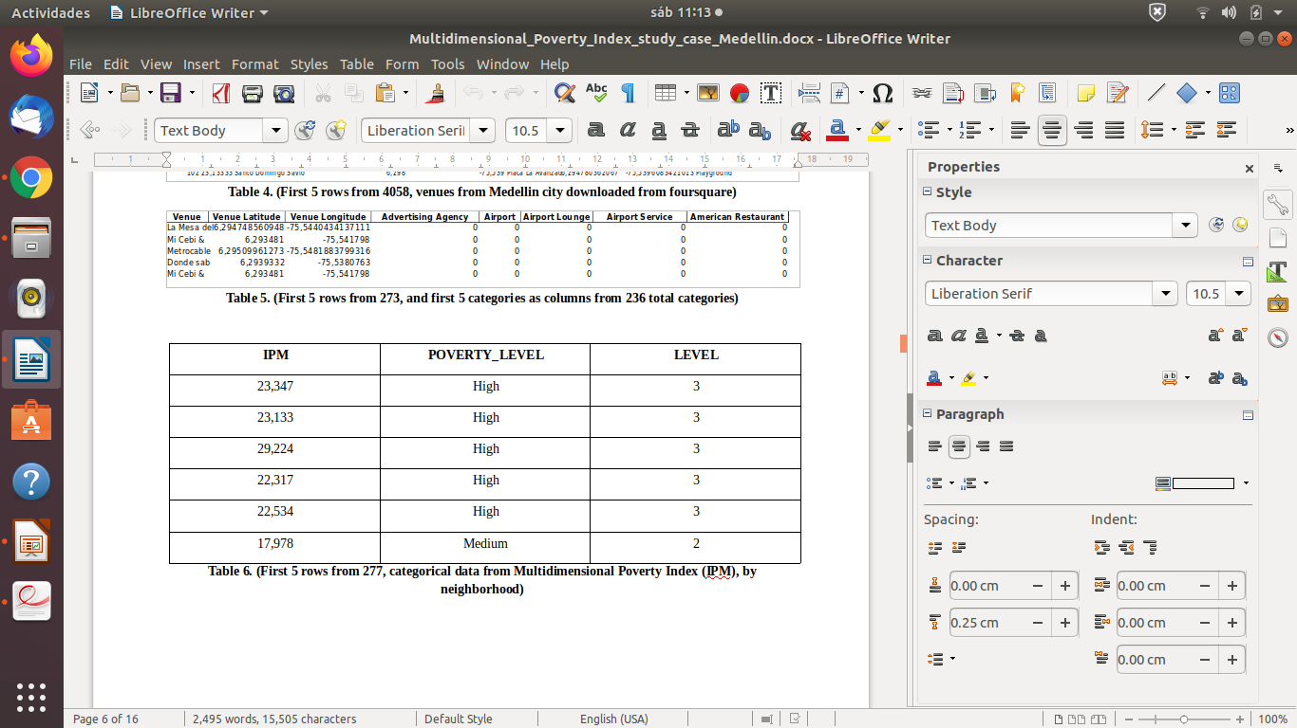
2.1 DATA CLEANING
Making dummies venues categories and ordering the venues data, now such as columns. The data available in foursquare, reduce data from 294 to 273 neighborhoods
First 5 rows from 273, and first 5 categories as columns from 236 total categories
In this project, Multidimensional Poverty Index (IPM) has a new categorical level: Low (0-10), Medium (10-20), HIGH (20-30) and very high >30.
First 5 rows from 277, categorical data from Multidimensional Poverty Index (IPM), by neighborhood
1

Slide 13
3. METHODOLOGY

Slide 14
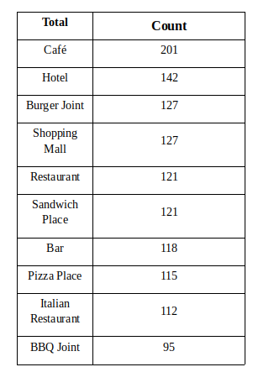
3.1 EXPLORATORY ANALYSIS
The amount of venues was about 4058 venues and 236 categories by 273 neighborhoods in Medellin city. In the next list, we have the top ten categories in the city.
Top ten categories in Medellin city.
1

Slide 15
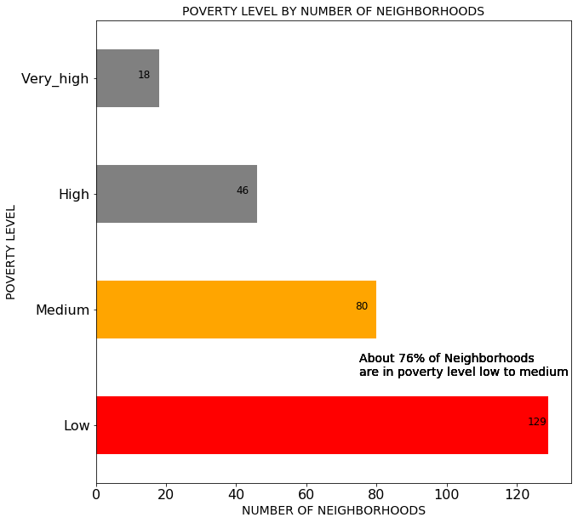
3.1 EXPLORATORY ANALYSIS
Multidimensional Poverty Index (IPM) has a classification from Low to very high, according to the all 273 neighborhoods, Low is the most frequent 129, Medium 80, High 46, and Very high 18. Fortunately about 76 % of neighborhood are low to medium values from urban zones.
Poverty level by number of neighborhoods. Low and Medium have about 76% of total neighborhoods.
1

Slide 16
3.1 EXPLORATORY ANALYSIS
Positive | IPM | Negative | IPM
Categories | Pearson | Categories | Pearson
Cable Car | 0,325716 | Pizza Place | -0,317615
Print Shop | 0,242016 | Supermarket | -0,306148
Rental Service | 0,163193 | Burger Joint | -0,303793
Construction & Landscaping | 0,129225 | Mexican Restaurant | -0,284867
Locksmith | 0,127111 | Restaurant | -0,260067
Other Great Outdoors | 0,12428 | Gym / Fitness Center | -0,247494
Playground | 0,119828 | Bar | -0,24739
Mountain | 0,1109 | Italian Restaurant | -0,239921
Science Museum | 0,108608 | Gym | -0,239022
Summer Camp | 0,095169 | Shopping Mall | -0,238117
Soccer Field | 0,095079 | Steakhouse | -0,232709
Campground | 0,082331 | Bakery | -0,229419
Aquarium | 0,07931 | Fast Food Restaurant | -0,225579
Planetarium | 0,078812 | Hotel | -0,215947
Mobile Phone Shop | 0,074887 | Seafood Restaurant | -0,213963
Making Pearson correlation between venues categories and Multidimensional Poverty Index (IPM) , with about 7 to 30% in Pearson values for positive and negatives top 15 correlations
Positive and negative Pearson correlation 30 categories with Multidimensional Poverty Index (IPM)
1

Slide 17
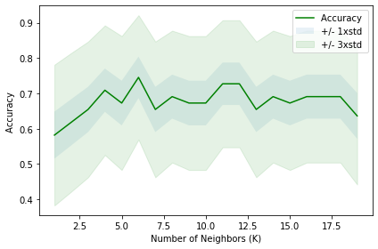
3.2 PREDICTIVE MODELING
Using first 25 from 30 categorical data get the best results
Several kind of algorithms were used in this study starting with K-Nearest Neighbors, Decision Tree, Support Vector Machine Evaluation and Logistic Regression.
K-Nearest Neighbors is an algorithm for supervised learning. Where the data is 'trained' with data points corresponding to their classification. Once a point is to be predicted, it takes into account the 'K' nearest points to it to determine it´s classification (1). With early 30 categories the best result was using the first 25 categories and the accuracy from 0,74 to K=6.
Training with 80% and test with 20%, and random state = 5.
Number of K and the best accuracy with K=6.
1

Slide 18
3.2 PREDICTIVE MODELING
Decision Tree Algorithm
The goal of using a Decision Tree is to create a training model that can use to predict the class or value of the target variable by learning simple decision rules inferred from prior data (training data).
In Decision Trees, for predicting a class label for a record we start from the root of the tree. We compare the values of the root attribute with the record’s attribute. On the basis of comparison, we follow the branch corresponding to that value and jump to the next node. (2)
Data= with decision tree, 80% were training data and 20 % test data, with random state = 5 and max depth = 5, and entropy criterion.
SVM (Support Vector Machines)
SVM works by mapping data to a high-dimensional feature space so that data points can be categorized, even when the data are not otherwise linearly separable. A separator between the categories is found, then the data is transformed in such a way that the separator could be drawn as a hyperplane. Following this, characteristics of new data can be used to predict the group to which a new record should belong.(1)
Data= Training with 80% and test with 20%, and random state = 5.
Logistic Regression
Logistic Regression is a variation of Linear Regression, useful when the observed dependent variable y, is categorical. It produces a formula that predicts the probability of the class label as a function of the independent variables. (1).
Data=Training with 80% and test with 20%, and random state = 5.
1

Slide 19
3. RESULTS

Slide 20
4. RESULTS
After use 25 from 30 categorical data with the best results and several kind of algorithms such as K-Nearest Neighbors, Decision Tree, Support Vector Machine Evaluation and Logistic Regression, we have final table with Jaccard and F1 score for each. (Table 9).
The best accuracy result was K-Nearest Neighbors with 73% F1 score using K= 6, follow by Logistic Regression with 64%.
Algorithm | Jaccard | F1_score
KNN | 0,607338 | 0,736754
Decision Tree | 0,34609 | 0,542054
SVM | 0,420294 | 0,502424
Logistic_Regression | 0,495667 | 0,64768
Accuracy table to several kind of algorithms.
1

Slide 21
25 venue categories
Cable Car
Print Shop
Construction & Landscaping
Caribbean Restaurant
Other Great Outdoors
Business Service
Betting Shop
Mountain
Home Service
Playground
Science Museum
Financial or Legal Service
Jewelry Store
Fabric Shop
Farm
Supermarket
Pizza Place
Burger Joint
Gym
Mexican Restaurant
Shopping Mall
Gym / Fitness Center
Bar
Bakery
Italian Restaurant
4. RESULTS
25 venue categories used to modeling.
Venue categories using to predict with 73 % of accuracy categorical poverty level in Medellin by Neighborhood
1

Slide 22
4.1 FINAL MAP
Creating a new map.
Geojson data has a column called 'CODIGO' with one zero before numbers when lenght =3, for example our column called ‘CODE’ for one Neighborhood is 101, but in Geojson is number is 0101. Then is necessary a new column with codes with equal codes in Geojson and draw IPM value for each neighborhood.
CODE | IPM | Neighborhoods | Boroughs | Lat | Long | POVERTY_LEVEL | LEVEL | CODIGO
101 | 23,347692 | Santo Domingo Savio No.1 | Popular | 6,298 | -75,544 | High | 3 | 0101
102 | 23,133333 | Santo Domingo Savio No.2 | Popular | 6,298 | -75,539 | High | 3 | 0102
103 | 29,224786 | Popular | Popular | 6,299 | -75,548 | High | 3 | 0103
104 | 22,317722 | Granizal | Popular | 6,292 | -75,546 | High | 3 | 0104
105 | 22,534454 | Moscú No.2 | Popular | 6,29 | -75,55 | High | 3 | 0105
106 | 17,978 | Villa Guadalupe | Popular | 6,288 | -75,551 | Medium | 2 | 0106
New column with the same name ‘CODIGO’ that geojson
1

Slide 23
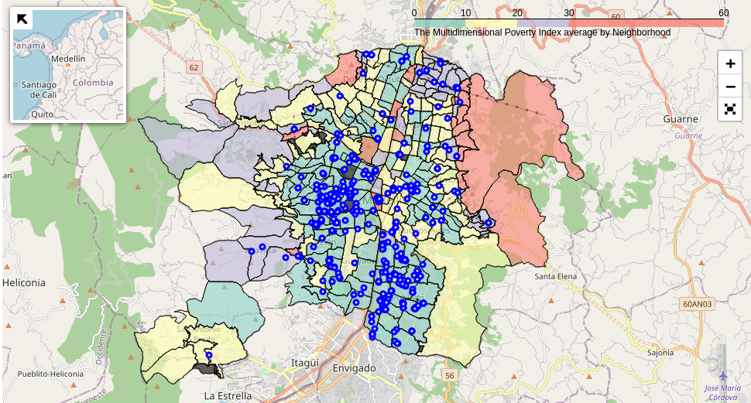
4.1 FINAL MAP
We can see that the very high values are in North and Northeast (Red colors) and low values from South to North, following almost a line (Green color), medium and high values around it with higher values to the west (Purple color. Center to South east corresponds to the best zone according to more values low and medium.
1
Map with 55% venues using to training and test model (blue) and categorical Multidimensional Poverty Index: Low (0-10) (Green), Medium (10-20) (Yellow), High (20-30) (Purple) and Very high >30(Red) in Medellin city, Colombia.

Slide 24
5. DISCUSSIONS

Slide 25
5. DISCUSSIONS
Clearly the worst zones correspond to mountain zones and boroughs around the urban city. These neighborhoods need especial attention. Prediction only with venues and categories is a good way to see the categorical poverty and local situation as an approximation, but not like a unique reference, because the lack of information, decreases better results and accuracy.
However, K-Nearest Neighbors model is a useful tool and could be the first step to have an idea about Multidimensional Poverty Index and using this information to possible new neighborhood constructions, marketing, territorial ordainment and set new strategies to reduce poverty to lowest values.
1

Slide 26
5. DISCUSSIONS
According to previous information recommendations are:
Extract all possible data from venues and improve model and accuracy to have better results.
Avoid lack of information like in the south west from the map with only one venue in five neighborhoods.
Many places are not clearly identified they are the black zones from the map, like parks and green zones and other places.
Places without houses or buildings does not have Multidimensional Poverty Index, and could create biases in a few neighborhoods
Mountain zones and big neighborhoods have a problem with coordinates, because we only use one point inside the neighborhood and with 600 meters of radio is not the best way, maybe those big neighborhoods needs two or more points
Choose categories is not an easy task, here is important evaluate categories and which ones are the better with entire data, according to correlation here was used 25 categories but with full data this could be changed.
1

Slide 27
6. CONCLUSIONS

Slide 28
6. CONCLUSIONS
Using a free foursquare account and coordinates from each neighborhood with radius of 600 meters, it could extract 4058 venues and 236 unique categories from Medellin city, Colombia. With a final data from 25 categories and 1073 venues use to training and test to 273 urban neighborhoods.
Several kind of algorithms were used in this study starting with K-Nearest Neighbors, Decision Tree, Support Vector Machine Evaluation and Logistic Regression. The best result was K-Nearest Neighbors with 73% of F1 score accuracy, using K= 6, follow by Logistic Regression with 64%.
Multidimensional Poverty Index (IPM) has a classification from Low to very high, according to the all 277 neighborhoods, Low is the most frequent 129, Medium 80, High 46, and Very high 18.
Very high values are in the North and Northeast and low values from South to North, medium and high values around it, with higher values to the west. Center to South east zone corresponds to the best zone according to more values low and medium in Medellin city.
1

Slide 29
6. CONCLUSIONS
Prediction to Multidimensional Poverty Index (IPM) only with venues and categories is a good way to see the categorical poverty and local situation as an approximation, but not like a unique reference, because the lack of information, decreases better results and accuracy. However, K-Nearest Neighbors model is a useful tool and could be the first step to have an idea about Multidimensional Poverty Index and use this information to possible new neighborhood constructions, marketing, territorial ordainment and set new strategies to reduce poverty to lowest values.
To next researches and improve this study is necessary to extract all possible data from venues in the entire city with a premium account at foursquare and building new models having accuracy above 73% and taking in count categories with higher weight in the full data.
1

Slide 30
7. REFERENCES

Slide 31
7. REFERENCES
1-IBM Developer skill Network. Data Science labs.
2-https://www.kdnuggets.com
Free software:
3-QGIS: https://www.qgis.org/es/site/
Free data:
Multidimensional Poverty Index Medellin, Colombia: https://geoportal.dane.gov.co/visipm/
Shapes Medellin Neighborhoods:
https://geomedellin-m-medellin.opendata.arcgis.com/datasets/barrio-vereda
Venues data download site:
www.foursquare.com
1

